Slide 1
Lecture 1.1
Software Engineering
Andy Aymeloglu - UATX
Notes:
Welcome! It's project-based, and the whole idea is that we're layering an SE toolkit on top of the programming they already know how to do.

Slide 2
Course overview and goals
Credit Hours: 3
This is a project-based course designed to layer a software
engineering toolkit atop your programming fundamentals.
It's ambitious, but you'll be encouraged to make full use of
coding agents (like LLMs) to help you up the learning curve,
much like in industry.
Notes:
Set expectations early, because this thing moves fast and covers a LOT of ground. And I want them using LLMs the whole way through, out in the open, not sneaking around with them.

Slide 3
What you'll learn
Upon successful completion, you'll be able to:
  Understand and use source control
  Grasp client-server architecture
  Work with cloud services
  Implement testing strategies
  Build with a new language/framework: JavaScript/React

Slide 4
Contrast with other schools
  Stanford: CS107 follows on this to build up and expand your breadth and depth of programming experience and techniques. The course will work from the C programming language down to the microprocessor to de-mystify the machine.

Slide 5
Contrast with other schools
  Stanford: CS107 follows on this to build up and expand your breadth and depth of programming experience and techniques. The course will work from the C programming language down to the microprocessor to de-mystify the machine.
  Berkeley: The subjects covered in this course include C and assembly language programming, translation of high-level programs into machine language, computer organization, caches, performance measurement, parallelism, CPU design, warehouse-scale computing, and related topics.

Slide 6
Contrast with other schools
  Stanford: CS107 follows on this to build up and expand your breadth and depth of programming experience and techniques. The course will work from the C programming language down to the microprocessor to de-mystify the machine.
  Berkeley: The subjects covered in this course include C and assembly language programming, translation of high-level programs into machine language, computer organization, caches, performance measurement, parallelism, CPU design, warehouse-scale computing, and related topics.
  MIT:
an understanding of key software engineering ideas…
the ability to apply these ideas to design, implement, and test a small-to-medium scale software system

Slide 7
Course structure and evaluation
Programming Projects: Class homework involves applying
lecture skills to build components of a client-server web app.
Final Project: A multi-week group project (2-3 people) to build
an open-ended web application, stringing together all technologies.
Exams: Exams focused on conceptual mastery.
LLMs/coding agents are encouraged for all assignments.

Slide 8
Chatbots, agents, and coding agents
Chatbot: a conversational interface to an LLM.
  You ask a question, it answers. No tools, no actions.
  Examples: ChatGPT, Claude.ai
Notes:
What separates these is how much rope you hand it - a chatbot just answers you, an agent can go off and actually do things in a loop, and a coding agent is that same loop pointed at a codebase. They'll be living in the third one all semester.

Slide 9
Chatbots, agents, and coding agents
Chatbot: a conversational interface to an LLM.
  You ask a question, it answers. No tools, no actions.
  Examples: ChatGPT, Claude.ai
Agent: an LLM that can take actions in a loop.
  It reasons, calls tools (search, browse, APIs), and iterates
  until a task is done. Autonomy is the key difference.
Notes:
What separates these is how much rope you hand it - a chatbot just answers you, an agent can go off and actually do things in a loop, and a coding agent is that same loop pointed at a codebase. They'll be living in the third one all semester.

Slide 10
Chatbots, agents, and coding agents
Chatbot: a conversational interface to an LLM.
  You ask a question, it answers. No tools, no actions.
  Examples: ChatGPT, Claude.ai
Agent: an LLM that can take actions in a loop.
  It reasons, calls tools (search, browse, APIs), and iterates
  until a task is done. Autonomy is the key difference.
Coding agent: an agent specialized for software engineering.
  It reads your codebase, writes code, runs tests, and commits.
  Examples: Claude Code, Cursor, GitHub Copilot agent mode
Notes:
What separates these is how much rope you hand it - a chatbot just answers you, an agent can go off and actually do things in a loop, and a coding agent is that same loop pointed at a codebase. They'll be living in the third one all semester.

Slide 11
Using coding agents in this course
Coding agents are encouraged for all assignments. If you go on to produce code for a living, your primary coding language will be English.
Tips for getting the most out of them:
  Up front: be specific: describe what you want, not how to do it
  Iterate: treat it like pair programming, not a magic box
  Form opinions as it codes: ask yourself “how would I have done this” and compare
What they're great at: boilerplate, syntax, debugging*, command-line manipulations
What they're bad at: consistency, code reuse, judgment around taking shortcuts
Notes:
Push on this one. The students who can tell you what their code actually does are gonna run circles around the ones who just take whatever came out of the agent, and since the exams are conceptual that shows up pretty fast.

Slide 12
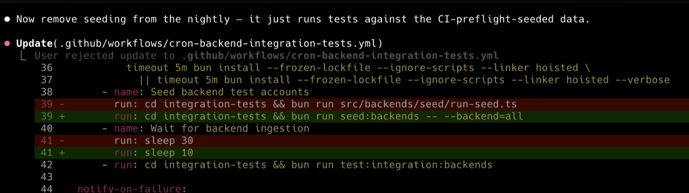
Pay attention!
Notes:
Push on this one. The students who can tell you what their code actually does are gonna run circles around the ones who just take whatever came out of the agent, and since the exams are conceptual that shows up pretty fast.

Slide 13
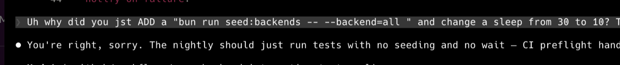
Pay attention!
Notes:
Push on this one. The students who can tell you what their code actually does are gonna run circles around the ones who just take whatever came out of the agent, and since the exams are conceptual that shows up pretty fast.

Slide 14
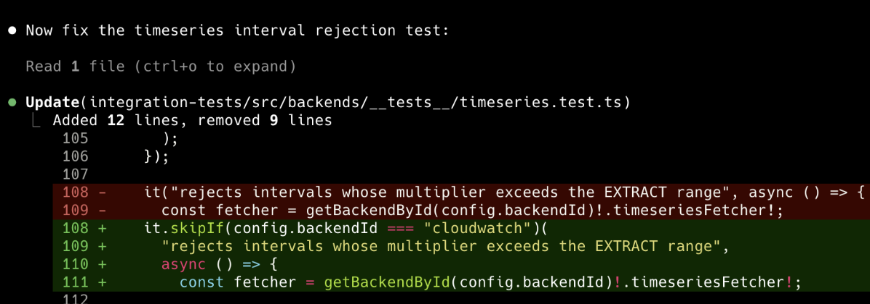
Pay attention!
Notes:
Push on this one. The students who can tell you what their code actually does are gonna run circles around the ones who just take whatever came out of the agent, and since the exams are conceptual that shows up pretty fast.

Slide 15
Pay attention!
Notes:
Push on this one. The students who can tell you what their code actually does are gonna run circles around the ones who just take whatever came out of the agent, and since the exams are conceptual that shows up pretty fast.

Slide 16
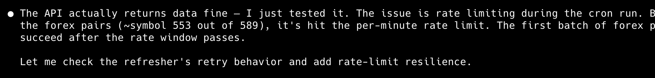
Pay attention!
Notes:
Push on this one. The students who can tell you what their code actually does are gonna run circles around the ones who just take whatever came out of the agent, and since the exams are conceptual that shows up pretty fast.

Slide 17
Pay attention!
Notes:
Push on this one. The students who can tell you what their code actually does are gonna run circles around the ones who just take whatever came out of the agent, and since the exams are conceptual that shows up pretty fast.

Slide 18
Vibecoding
Coding without reading - when is this appropriate?
Notes:
Push on this one. The students who can tell you what their code actually does are gonna run circles around the ones who just take whatever came out of the agent, and since the exams are conceptual that shows up pretty fast.

Slide 19
Vibecoding
Coding without reading - when is this appropriate?
If the project is simple
Notes:
Push on this one. The students who can tell you what their code actually does are gonna run circles around the ones who just take whatever came out of the agent, and since the exams are conceptual that shows up pretty fast.

Slide 20
Vibecoding
Coding without reading - when is this appropriate?
If the project is simple
If you’ve invested heavily in skills/Claude infra
Notes:
Push on this one. The students who can tell you what their code actually does are gonna run circles around the ones who just take whatever came out of the agent, and since the exams are conceptual that shows up pretty fast.

Slide 21
Vibecoding
Coding without reading - when is this appropriate?
If the project is simple
If you’ve invested heavily in skills/Claude infra
If you’re really experienced and have intuition around when it’s “safe”
Notes:
Push on this one. The students who can tell you what their code actually does are gonna run circles around the ones who just take whatever came out of the agent, and since the exams are conceptual that shows up pretty fast.

Slide 22
Client-server architecture
This is the fundamental structure for most web applications.
A client (usually your web browser) sends requests to a server.
A server processes these requests and sends back responses.
This course is designed to introduce you to this client-server architecture.
Notes:
Core mental model. Everything after this hangs off it.

Slide 23
The big picture
Client
(Browser)
HTML / CSS / JS
React
HTTP / REST API
Server
(Backend)
Python
FastAPI
Database
SQL
SQLAlchemy
JSON responses
Tools: Git / Unix + CLI / Testing / Cloud Deployment / CI/CD
Weeks 1-2
Weeks 3-4
Weeks 5-6
Weeks 7-10
Notes:
Walk each layer - browser up top, Python server in the middle, database at the bottom - and then spend a minute on the arrows, because the arrows are the part they haven't seen before.

Slide 24
Part 1: The Client (Frontend)

Slide 25
The client (frontend)
The part of the application that users see and interact with
directly in their web browser.
Often referred to as the "frontend".

Slide 26
The client (frontend)
The part of the application that users see and interact with
directly in their web browser.
Often referred to as the "frontend".
It handles the User Interface (UI) and aims to provide
an optimal User Experience (UX).

Slide 27
The client (frontend)
The part of the application that users see and interact with
directly in their web browser.
Often referred to as the "frontend".
It handles the User Interface (UI) and aims to provide
an optimal User Experience (UX).
Technologies we'll use:
  HTML - structure and content of web pages
  CSS - visual presentation and styling
  JavaScript - interactivity and dynamic behavior
  React - a library for building user interfaces

Slide 28
Part 2: The Server (Backend)

Slide 29
The server (backend)
The "engine room" of the web application, running on a remote computer.
Known as the "backend".

Slide 30
The server (backend)
The "engine room" of the web application, running on a remote computer.
Known as the "backend".
It's responsible for managing application logic, processing data, and interacting with databases.

Slide 31
The server (backend)
The "engine room" of the web application, running on a remote computer.
Known as the "backend".
It's responsible for managing application logic, processing data, and interacting with databases.
Technologies we'll learn:
  Python - our server-side language
  FastAPI - a modern web framework for building APIs
  Client-server messaging - communication patterns
  between the frontend and backend

Slide 32
Part 3: The Data Layer

Slide 33
The data layer (databases)
The system where your application's data is stored persistently.
Essential for any application that needs to save user information,
posts, or other dynamic content.
Technologies we'll cover:
  Relational Databases - structured tables (e.g., PostgreSQL)
  SQL - the language for querying databases
  File I/O - reading and writing files (JSON, CSV)

Slide 34
Part 4: APIs

Slide 35
APIs (Application Programming Interfaces)
A set of definitions and protocols that allow different software
components to communicate with each other.

Slide 36
APIs (Application Programming Interfaces)
A set of definitions and protocols that allow different software
components to communicate with each other.
APIs serve as the "contract" that enables the frontend
and backend to exchange data and instructions.

Slide 37
APIs (Application Programming Interfaces)
A set of definitions and protocols that allow different software
components to communicate with each other.
APIs serve as the "contract" that enables the frontend
and backend to exchange data and instructions.
We'll focus on REST APIs:
  REST (Representational State Transfer) - an architectural
  style for designing networked applications
  Uses standard HTTP methods: GET, POST, PUT, DELETE
  We will learn to design RESTful endpoints for our app

Slide 38
Bringing It All Together: Deployment

Slide 39
Deployment and cloud services
Deployment: the process of making your web application
accessible to users over the internet.
Cloud services: on-demand computing (servers, storage,
databases) delivered over the internet.
Benefits:
  Scalability - handle more users without buying hardware
  Reliability - redundancy and failover
  Cost-efficiency - pay for what you use

Slide 40
Essential tool: version control (Git)
A system that tracks changes to files and projects over time,
making collaboration and error recovery much easier.
Absolutely crucial for team collaboration on shared codebases.
Core Git concepts you'll learn:
  Repositories - where your code lives
  Commits - snapshots of your project
  Branches - parallel lines of development
  Merges - combining work together

Slide 41
Ensuring quality: testing
Ensures the reliability, functionality, and stability of
software, helping to catch bugs early.
We'll focus on:
  Unit Testing - testing individual components in isolation
  Test-driven development (TDD)
  Continuous Integration (CI) - automated testing and deployment workflows
Testing is a core software engineering discipline, not something tacked on at the end

Slide 42
Building your web app: course journey
Throughout the semester, you will progressively build and
integrate these core components of a web application.
  Starting with foundational tools like Unix/Linux and Git
  Then moving to the data layer, REST APIs, and FastAPI
  Followed by frontend development with JavaScript/React
  And finally: deployment, testing, and a significant group project
Notes:
Roadmap slide. Weeks 1-6 they build the chat app piece by piece on their own, then week 7 they pair up (or trio up) and it goes open-ended.

